Slide 1
Mobile-Commerce Development
Lesson
Content Provider
Lecturer:
Tran Duy Thanh, Phd
Nguyen Quang Phuc, Msc
Email: thanhtd@uel.edu.vn
Blog: https://tranduythanh.com
Phone: 0987773061

Slide 2
Lesson Objective
Students understand Content Provider
Students use Content Provider for accessing and saving Contacts
Students access call log by Content Provider
Students access the SMS information
Students access Media in device

Slide 3
Outlines
Introducing Content Provider
Read and Write Contacts
Accessing Call Log
Accessing SMS
Accessing Media

Slide 4
1. Introducing Content Provider
ContentProvider is a data access management component that provides various methods for applications to access data from other applications through the ContentResolver object.
An application can manage access to data saved by that application through the ContentProvider.
Data is managed by ContentProvider like a relational database: query, add, update, and delete operations are performed through the methods: query(), insert(), update(), delete().

Slide 5
1. Introducing Content Provider
CONTENT PROVIDER
getContentResolver()
Data request
URI – Uniform Resource Identifier
Content Resolver
CRUD operations
Contacts App
What’s App/
Skype/Zalo/Viber
CONTENT PROVIDER
Data response
Cursor
ANDROID OS

Slide 6
2. Read and Write Contacts
Request permission
Read Contacts
<uses-permission android:name="android.permission.READ_CONTACTS" />
Uri uri =ContactsContract.CommonDataKinds.Phone.CONTENT_URI; Cursor cursor = getContentResolver().query(uri, projection: null, selection: null, selectionArgs: null, sortOrder: null);
while (cursor.moveToNext()){ int nameIndex =cursor.getColumnIndex(ContactsContract.Contacts.DISPLAY_NAME); String name = cursor.getString(nameIndex); //Get Name int phoneIndex =cursor.getColumnIndex(ContactsContract.CommonDataKinds. Phone.NUMBER); String phone = cursor.getString(phoneIndex); //Get Phone Number //Todo something … } cursor.close();

Slide 7
2. Read and Write Contacts
Request permission
Write Contacts
<uses-permission android:name="android.permission.WRITE_CONTACTS" />
Uri addContactsUri = ContactsContract.Data.CONTENT_URI; //Add an empty contact and get the generated Id long rowContactId = getRawContactId(); //Add contact name data insertContactDisplayName(addContactsUri, rowContactId, “Mr ….”); //Add phone number insertContactPhoneNumber(addContactsUri, rowContactId, “0903778899”);
private long getRawContactId() {//Insert an empty contact ContentValues values = new ContentValues(); Uri rawContactUri = getContentResolver().insert(ContactsContract.RawContacts.CONTENT_URI, values); return ContentUris.parseId(rawContactUri); }

Slide 8
2. Read and Write Contacts
Write Contacts
private void insertContactDisplayName(Uri addContactsUri, long rawContactId, String displayName) { ContentValues values = new ContentValues(); values.put(ContactsContract.Data.RAW_CONTACT_ID, rawContactId); values.put(ContactsContract.Data.MIMETYPE,
ContactsContract.CommonDataKinds. StructuredName.CONTENT_ITEM_TYPE);
values.put(ContactsContract.CommonDataKinds.StructuredName.GIVEN_NAME, displayName); getContentResolver().insert(addContactsUri, values); }

Slide 9
2. Read and Write Contacts
Write Contacts
private void insertContactPhoneNumber(Uri addContactsUri, long rawContactId, String phoneNumber) { ContentValues values = new ContentValues(); values.put(ContactsContract.Data.RAW_CONTACT_ID, rawContactId); values.put(ContactsContract.Data.MIMETYPE,
ContactsContract.CommonDataKinds.Phone.CONTENT_ITEM_TYPE); values.put(ContactsContract.CommonDataKinds.Phone.NUMBER, phoneNumber); getContentResolver().insert(addContactsUri, values); }

Slide 10
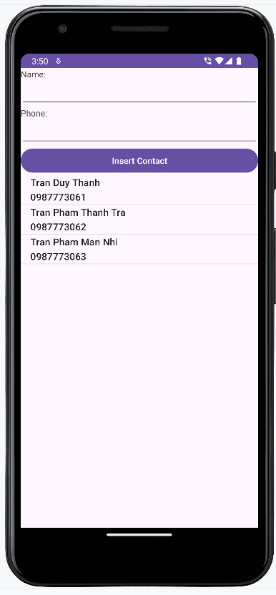
2. Read and Write Contacts
Exercise
How to show Confirmation Dialog for Permission as automatically ?

Slide 11
3. Accessing Call Log
Request permission
<uses-permission android:name="android.permission.READ_CALL_LOG" />
String[] projection = new String[]{CallLog.Calls.DATE,
CallLog.Calls.NUMBER,
CallLog.Calls.DURATION};
Cursor cursor = getContentResolver().query(
CallLog.Calls.CONTENT_URI,
projection: projection, selection: null, selectionArgs: null,
sortOrder: null);

Slide 12
3. Accessing Call Log
SimpleDateFormat dateFormat =
new SimpleDateFormat("dd/MM/yyyy HH:mm:ss"); while (cursor.moveToNext()){ Date date = new Date(cursor.getLong(0)); String sDate = dateFormat.format(date); String number = cursor.getString(1); long duration = cursor.getLong(2); //Todo something … } cursor.close();

Slide 13
4. Accessing SMS
Request permission
<uses-permission android:name="android.permission.READ_SMS" />
Uri uri = Uri.parse("content://sms/inbox"); Cursor cursor = getContentResolver().query(uri, projection: null, selection: null, selectionArgs: null, sortOrder: null);
int phoneColumnIdx = cursor.getColumnIndex("address"); int timeColumnIdx = cursor.getColumnIndex("date"); int bodyColumnIdx = cursor.getColumnIndex("body"); while (cursor.moveToNext()){ String phoneNumber = cursor.getString(phoneColumnIdx);
Date date = new Date(cursor.getLong(timeColumnIdx));
String content = cursor.getString(bodyColumnIdx); //Todo something … } cursor.close();

Slide 14
5. Accessing Media
Request permission
<uses-permission
android:name="android.permission.READ_EXTERNAL_STORAGE" />
String[] projection = { MediaStore.MediaColumns.DISPLAY_NAME, MediaStore.MediaColumns.DATE_MODIFIED, MediaStore.MediaColumns.MIME_TYPE }; CursorLoader cursorLoader = new CursorLoader(MainActivity.this, MediaStore.Images.Media.EXTERNAL_CONTENT_URI, projection, null, null, null); Cursor cursor = cursorLoader.loadInBackground();

Slide 15
5. Accessing Media
while (cursor.moveToNext()){ String name = cursor.getString(0); Date date = new Date(cursor.getLong(1)); String type = cursor.getString(2); //Todo something … } cursor.close();

Slide 16
Discussions
Q1: What are advantages of Content Provider?
Q2: How to Delete Contact from device?
Q3: How to Access Call log between dates [from … to]?
Q4: How to access SMS inbox
Q5: How to read Image from SD Card?

Slide 17
Next Lesson
Broadcast Receiver

Slide 18
THANK YOU!

